Slide 1





Schulich Ignite 2020

Slide 2
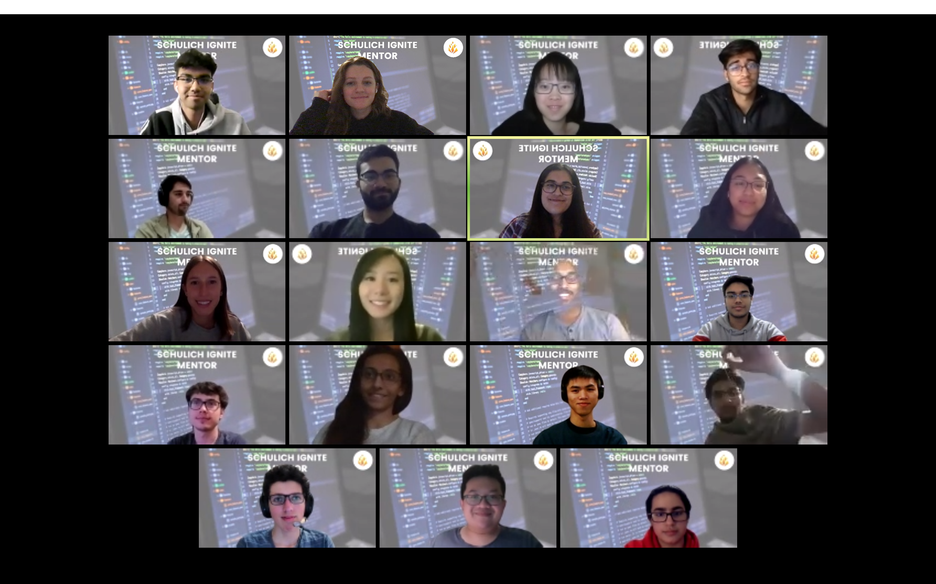
Notes:
Anmol and Moshi speak: Intro of what we do, mention end of program gala to demo final projects, intro to all the mentors

Slide 3
Program Overview
Six interactive and fun sessions
Exercise and project oriented approach
Creativity is highly valued
Workshops are meant to give students a hands on experience with programming
Notes:
We’ll learn processing, which gives us an easy way to display stuff on the screen, everything else we do is raw programming and very applicable to any other programming you do. We’ll do this over 6 lecture then we’ll have 2 more to work on your own projects, maybe a game or a piece of art or maybe even graphing programs. This will be very hands on you’ll be practicing nearly everything we mention here.

Slide 4
Content overview
Session 1: Variables, Mouse Movement, setup() and draw()
Session 2: Operators, Moving objects
Session 3: If-Statements, Logical Operators
Session 4: Arrays, Loops part 1
Session 5: Loops part 2
Session 6: Functions
Notes:
More detailed version of our things, we’ll cover this stuff so don’t worry!

Slide 5

Content slides
Website: https://schulichignite.com/
Here’s where you can see all the content slides for all of our sessions
Examples also live here!
Notes:
Website, if you’re behind in the slides, you can get them here!

Slide 6

Ignite points
Points that can be collected to win prizes! Can be collected through:
Consistent attendance (Streak Score)
Answering quick questions exercises
Submitting end-of-session exercises
Submitting social media weekly challenges
Submitting end-of-term projects

Slide 7


TWO CATEGORIES: PYTHONIC LAVA & BUG BUSTERS!
Students are divided into two categories based on their skill level in coding
No experience in code: Bug Busters
Experience in code: Pythonic Lava
Students competing against others in the same category
Each category gets a different exercises to submit
Each category has its own prizes!

Slide 8
TWO CATEGORIES: PYTHONIC LAVA & BUG BUSTERS!
To double check which category you are in, find your name in one of the sheets named Pythonic Lava and Bug Busters in this spreadsheet
The top 2 people with the most Ignite Points from each category by the end of the 8 weeks win prizes!
1st: $25 Amazon eGift Card
2nd: $20 Amazon eGift Card
Notes:
https://docs.google.com/spreadsheets/d/1iyzEQ-rgPnUfVVIvJK2HBrGn6l6HatGrT6i3GLoxdUM/edit?usp=sharing

Slide 9
In-Class QUESTIONS
Slides with this logo have questions that can be answered for points!
Worth 10-20 points each
Can be answered directly in the chat or by unmuting yourself. The first to correctly answer an in-class question receives the Ignite Points!
Notes:
Participation is optional but highly encouraged for both

Slide 10
End-of-session exercises & Weekly challenges
Worth 50 points each
Weekly Challenges uploaded every Monday at 5:00 PM on our Instagram page (@schulichignite) and Facebook page (Schulich Ignite)
Need to submit a program as your answer to the relevant submission form
If you are in Bug Busters, submit your exercises to this form: https://forms.gle/i9wBksTAbuGmYRWRA
If you are in Pythonic Lava, submit your exercises to this form: https://forms.gle/CV4HBe3Pra6EAALw6

Slide 11
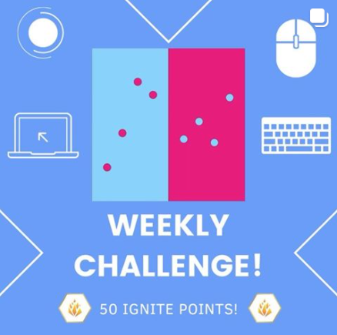
Weekly Challenges
What they looked like in the summer. Will look a little different in the Fall!
Notes:
An example of what the weekly challenges looked like in the winter. Will probably look a little different in the summer sessions, but they will look something like this

Slide 12
STREAK SCORE
You will get awarded for consistent attendance!
For your first attended session, you get 5 points, but with each consecutive session you attend, you get 5 more points each session!
Example on the next slide

Slide 13
Streak score example
SmartPuppy is a Schulich Ignite mentee who attended all the 8 weekly sessions except for session 6, since they had soccer training that day. SmartPuppy would receive 5 points for attending session 1, 10 points for session 2, 15 points for attending session 3, 20 points for attending session 4, 25 points for attending session 5, 0 points for not attending session 6, 5 points for attending session 7 (since they missed one session, their streak score resets!), and 10 points for attending session 7.
Notes:
Just read this

Slide 14
IGNITE POINT SPREADSHEET
Find the scoreboard for each category
Find how many points you have
Find how many points you receive for your submissions
Find all the rules and FAQs (highly recommended to read those!)
Read about projects
Ignite Points spreadsheet link: https://docs.google.com/spreadsheets/d/1iyzEQ-rgPnUfVVIvJK2HBrGn6l6HatGrT6i3GLoxdUM/edit?usp=sharing
If you have any questions about Ignite Points, ask on #ignitepoints on Discord, or ask your assigned mentor

Slide 15
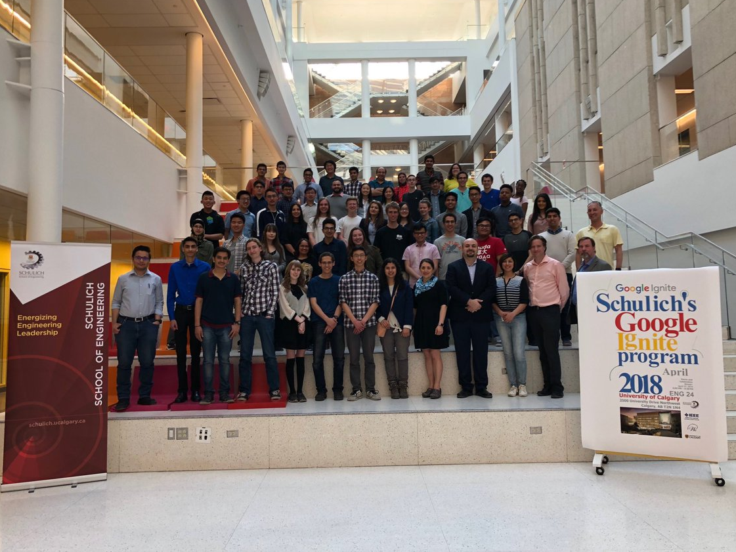
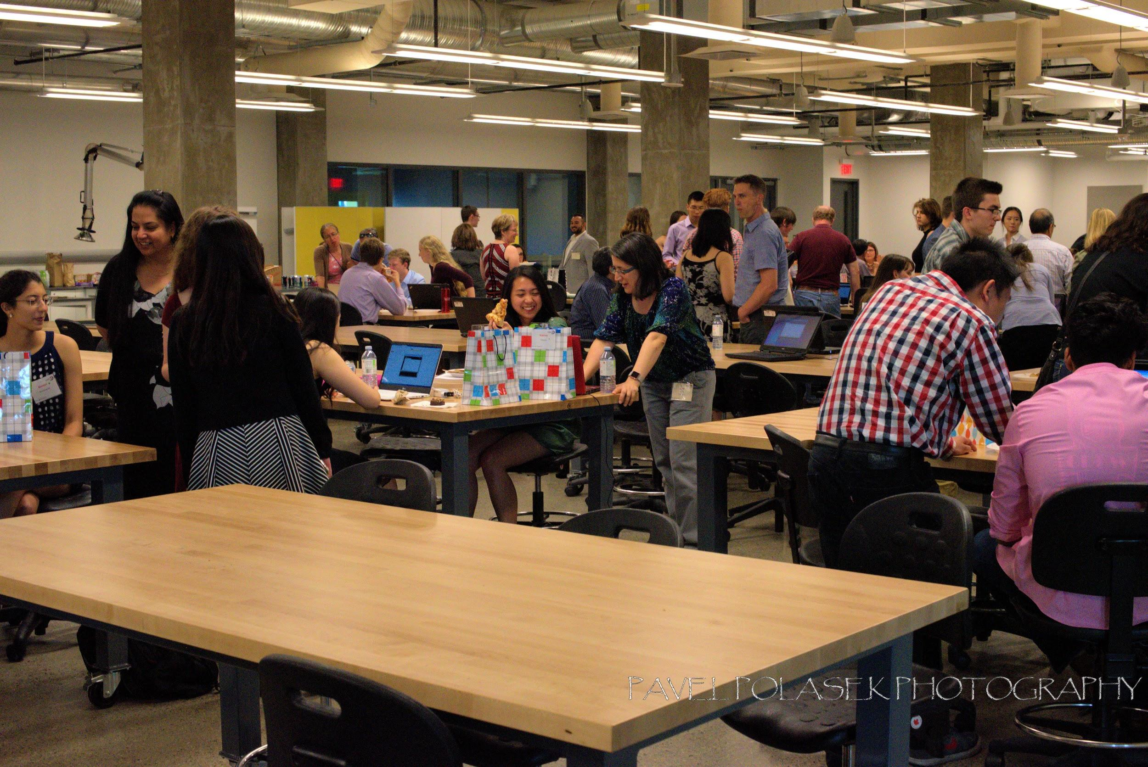
Notes:
After the 8th session everyone we’ll have a end of program dinner to demo our final projects, come by we’ll get food (prob) and even if you don’t finish come by and show off what you got, we know it’s not easy and knowing you put in the work makes our jobs of mentor so much more rewarding.

Slide 16
What is Software Engineering and its benefits?
Notes:
If Monshipour.present():
Monshipour.speech()

Slide 17
ICEBREAKER
Time!

Slide 18
Icebreaker activity with your group!
Time for introductions! With your group answer the following questions:
What’s your name?
What is your favorite smell?
Name something about programming that interests you
Talk to your mentors?
Notes:
Approx 5 minutes
Get them talking, comfortable it’s going to be road ahead

Slide 19
What is the difference between humans and computers?
Notes:
Imagine I had a person and a robot standing next to me. First i turn to the human and i ask them to grab a pen from the room above us. So what would they do? Well first they walk out the door, down the hallway, up the stairs down the upper hallway, into the door up there and past any human to grab the pen. They then repeat this whole process to come back to me and pass me the pen.
Now I turn to the robot and ask it to get the pen, what will they do?
The robot will jump through the roof, walk over to the pen crushing any humans and tables in its path. Grab the pen bust through the floor landing on top of me flattening my body. Why did it do that?
Well because I didn’t tell the robot not to break property. I did not tell it to avoid people. I did not tell the robot to put the pen in and my hand and not on top of my pancake of a body. This is the fundamental property of computers, they don’t understand these implicit things such as avoid people. They do things Exactly how we tell them. But why do we need the robot then if a human is so much easier to work with? Well how many times could i get the person to run up and down the stair before they get tired? Could they do it 24/7? Do they need breaks? See that’s the beauty of computers, they will work constantly never taking a break, never complaining. Always doing the exact same thing always predictable. So for this program we will learn the basics of talking to computers so that we can make it do what we want, and not bust through a wall like the kool-aid man. This is why computers are useful, once you’ve told it what to do, you never have to tell what to do again.

Slide 20

Let’s Get Started!

Slide 21
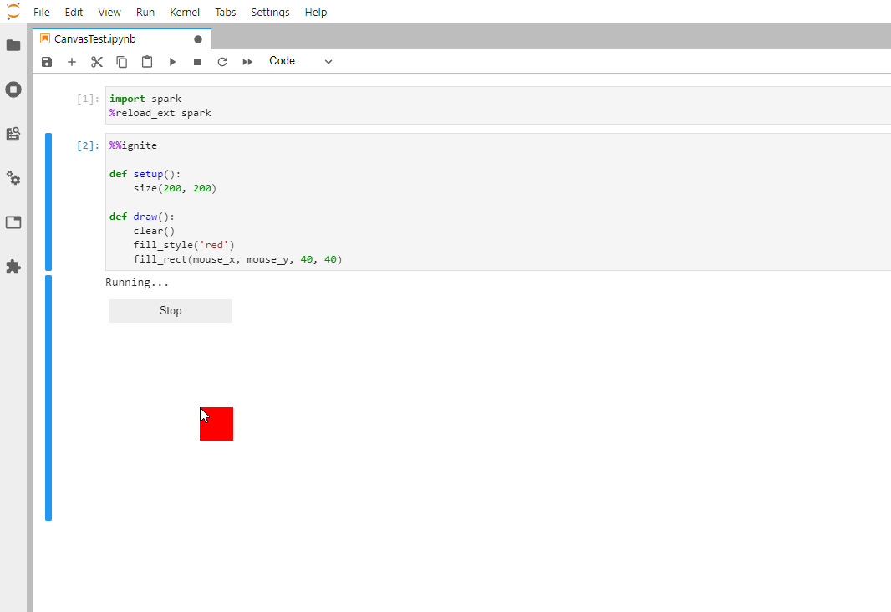
Our Tools
Python: The 4th most used & 3rd best loved programming language around the world
Platform: We have a new platform at ignite.aranite.com, no downloads needed! Spark: A library we built to keep things simple, and let you get right to coding!
Notes:
Processing is a good way to learn programming, it handles some complex stuff like displaying things on the screen. Even though we’re using Python, everything you learn here is applicable when you learn and work with different languages.
The syntax, or rather the punctuation of the language may change but the what you can do and the way you think about how to talk with computers remain relatively the same.

Slide 22
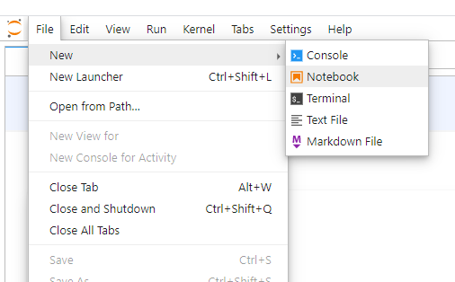
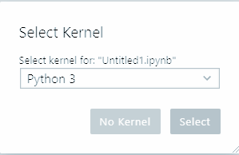

Getting Started - Where Do I Code?
Let’s open a notebook!
If you already have a tab called “Untitled.ipynb”, you can skip this slide
Go to File → New → Notebook
Press Select

Slide 23


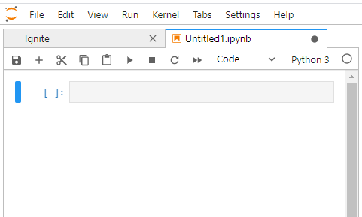
Getting Started - Where Do I Code?
There are 2 toolbars
The button is on the 2nd toolbar
The grey rectangle is a cell
Type code inside!
Can have more than 1 cell
Toolbar 1
Toolbar 2
Cell: Type here!

Slide 24
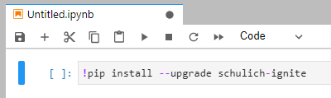
Getting Started - Ignite Code
Click the cell and type:
!pip install --upgrade schulich-ignite
Press the button in the toolbar
(You can also press SHIFT + Enter on the cell)
You’ll see a lot of text. DON’T PANIC! (We can delete this cell after its done!)
Start
Stop

Slide 25
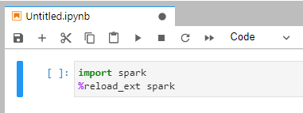
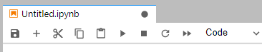
Getting Started - Ignite Code
Scroll down, click the new cell and type:
import spark %reload_ext spark
Press the button in the toolbar
(Or press SHIFT + Enter)
Start
Stop

Slide 26
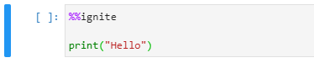
Getting Started - Ignite Code
Scroll down, click the new cell and type:
%%ignite print("Hello world")
Press the button in the toolbar
(Or press SHIFT + Enter)
Start
Stop

Slide 27
The Basics!
Notes:
Why waste time say lot word when few word do trick

Slide 28
Setup
For now, all code goes inside setup
def setup(): code down here and here
1 Single “Tab”
Notes:
Setup, the place where you setup your code. Pay attention to indents! One single tab for all of the code that will be in setup

Slide 29
Tell me something!
print() prints words to the console (the little box on the next cell)
Very useful to see that’s going on in your program.
Comments: Anything after # is ignored as a comment until the end of the line. Very useful for programmers!
print("Hello world") # How to print hello
Notes:
Print is a basic way of letting the computer talk to us.
# Type println(“hello [name]”)
First we type the command we want the computer to do, in this case it’s println (line)
But it needs something to print, how are we going to tell the computer this?
Well see these round brackets? This is where we put anything we want to give the computer, which you can see is “hello”
But why the double quotations? Because computers are very picky about how you give them different types of information, putting the quotation marks beside it tells the computer it’s a word and not something like an number (yes computers are that dumb)
The semicolon at the end tells the computer, stop looking for a command this is all of it right here
# Run code and see show how it prints out “hello [name]”
Comments is prefixed by # and then anything you want to type, it signals to the computer that you are not talking to it but yourself

Slide 30
Size()
Drawing needs a screen to draw on.
Set the size with size(width, height)
# Make the screen 800 wide and 600 tall size(800, 600)

Slide 31
Let’s Draw Something!
fill_rect(x, y, w, h)
x : x-coordinate of the top left corner y : y-coordinate of the top left corner w : width of rectangle h : height of rectangle
(x,y)
Height
Width
Notes:
Words are cool but what about like a picture? What about shapes?
Let’s do a Rectangle or Rect let’s draw a rectangle that’s in the middle of the screen with size of 100,100
Explain parameters
Don’t forget to explain size as well, type in size(500,500); or something Huh that’s a square, well i wanted a rectangle? I wonder how do i change it to make it a rectangle?
Play around with the parameters for a bit and make new rectangles
Encourage explorations for themselves.
Also show how it goes x -> and y from bottom to up, it’s weird like that

Slide 32
Another shape
fill_circle(x, y, diameter)
x : x-coordinate of the centre of the ellipse y : y-coordinate of the centre of the ellipse d: diameter of the circle
(x,y)
Diameter
Notes:
Answer: circle(10, 10, 20)

Slide 33

Quick Question #1
10
What values of x, y and d gives a circle:
with 50 radius and
has the edges of the circle touch the top left corner of the screen?
fill_circle(x, y, d)
Colours not needed

Slide 34
Colours
OR
set_fill(r, g, b)
r : Red amount g : Green amount b : Blue amount
NOTE: All colour amounts must be between 0 and 255
set_fill("color")
Examples:
Red: set_fill("red")
Green: set_fill("green")
Blue: set_fill("blue")
NOTE: Name of color must have double quotes around it (this is because it is a string, we will learn more about that later!)
Notes:
My grey rectangles are kinda lame, how do we add colours? Well fill is the solution! We pass it 3 numbers, some amount of red, some amount of green, and some amount of blue.
Because of computer things it’s a value between 0 and 255 where 255 is maximum colour Just like in grade 2, with red, yellow, blue you can mix these colours to get any other colours!
Try this feature out and draw something more complex, here are some examples you could try drawing.
~15 mins

Slide 35
Background
OR
background(r, g, b)
r : Red amount g : Green amount b : Blue amount
NOTE: All colour amounts must be between 0 and 255
background("color")
Examples:
Red: background("red")
Green: background("green")
Blue: background("blue")
NOTE: Name of color must have double quotes around it (this is because it is a string, we will learn more about that later!)
Notes:
My grey rectangles are kinda lame, how do we add colours? Well fill is the solution! We pass it 3 numbers, some amount of red, some amount of green, and some amount of blue.
Because of computer things it’s a value between 0 and 255 where 255 is maximum colour Just like in grade 2, with red, yellow, blue you can mix these colours to get any other colours!
Try this feature out and draw something more complex, here are some examples you could try drawing.
~15 mins

Slide 36
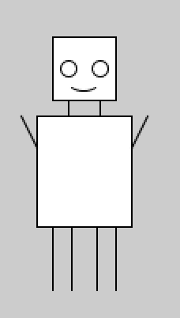
Try it Yourself!
Choose one of the following to draw (10 mins):
Draw a house
Draw a snowman
Draw a car
Draw a robot
Make something up on your own!

Slide 37
Variables
Notes:
Variables are containers for things, they hold something inside. This is much like a box.

Slide 38
Variables
age = 23
Has a name, what you’re calling it
It stores a value, the thing it contains
Useful tip: variables also have a type, what it contains (Number or text)
Name
Value

Slide 39
Types - Integer
As you guessed an integer is just an… integer
(Therefore, does not include decimals)
This includes positive and negative numbers
SYNTAX:
age = 19
Notes:
Integers! I hope you know them because they are just whole numbers, be it positive or negative. To tell the computer this variable is an integer you type “int” as the type Integer.
Things like 4, -6, 1 billion are all valid, but things like 1.1 is not.

Slide 40
Types - Float
Use this for all of your decimal dreams
This also include positive and negative decimals
SYNTAX:
salary = 3000.29
Notes:
Float, a strange name but they contain any number you can think of! 1 trillion, -3.7, 3.1415
To tell the computer it’s a float we type float as the type name.

Slide 41
Types - String
Fancy name for text (or a string of letters). Just wrap the text in quotation marks (you can use " or ', as long as it’s the same on both sides)
SYNTAX:
first_name = "janice"
last_name = 'smith'
We’ll be using double quotes (")
Notes:
Strings, or otherwise known as a “String” of characters. These are words, sentences and even entire paragraphs.
It tells the computer what you see here is just words.
Sadly there are no negative strings because, what does that even mean? Interesting note for words you must use double quotations because the computer kinda thinks its the name of another variable otherwise.

Slide 42
Quick Question #2
10
What is the type of this variable?
today = "10.17"

Slide 43
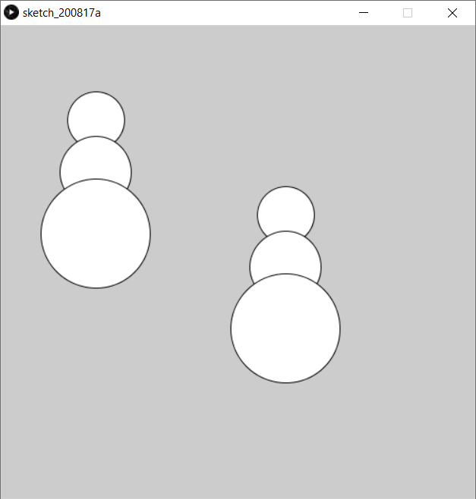
Exercise: Using Variables, part 1
Start by typing out this code for 2 snowmen…
fill_circle(100, 100, 60) fill_circle(100, 155, 75) fill_circle(100, 220, 115)
x = 300 y = 200 fill_circle(x, y, 60) fill_circle(x, y + 55, 75) fill_circle(x, y + 120, 115)
#1
#2

Slide 44
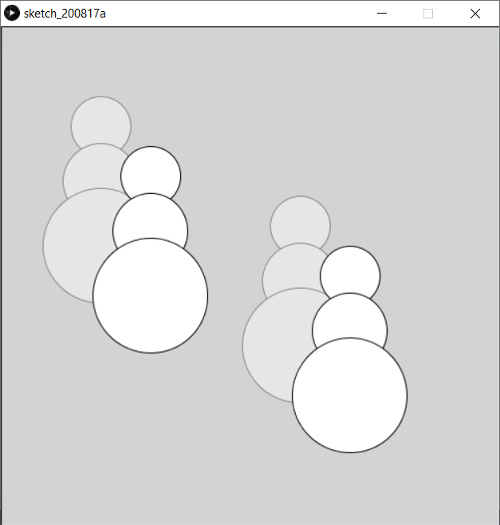
Exercise: Using Variables, part 2
Now move them both
50 pixels right
50 pixels down
What’s the least number of lines you need to change?
Which snowman was easier to move?
#1
#2

Slide 45
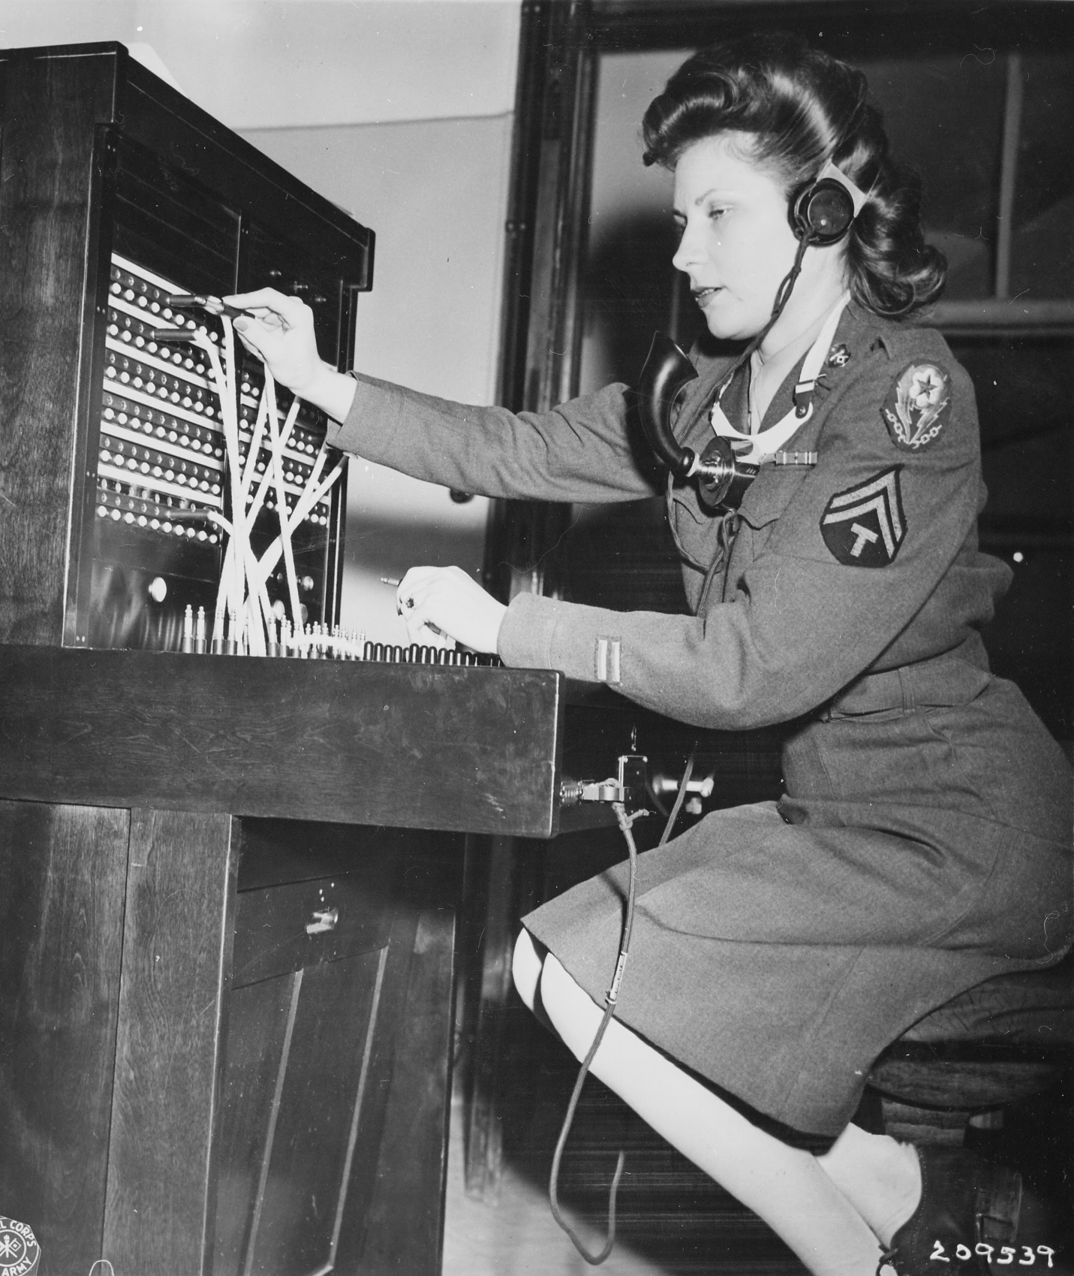
Operators*
*Not a phone operator
Notes:
I have a confession to make everyone…. It’s math...

Slide 46
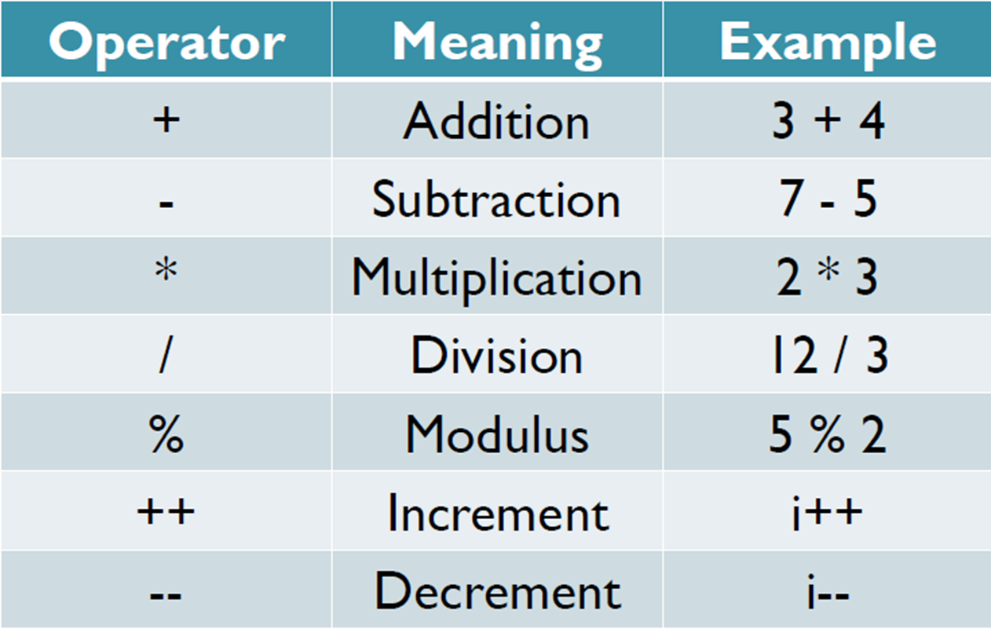
Arithmetic operators
Notes:
This slide is pretty obvious, except for modulus, increment, and decrement.
Modulus gives the remainder of a division. Odds are that you’ll never use it, but ask your mentors for more info about this if you’re curious

Slide 47
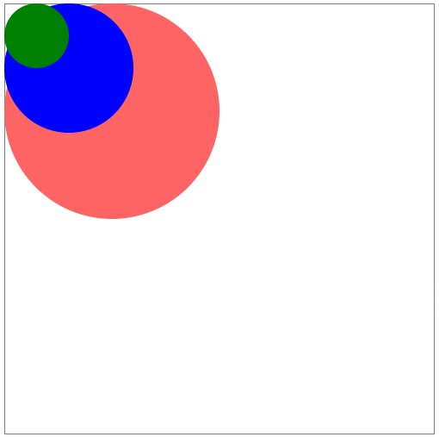
Quick Question #3
20
How could you use variables, arithmetic operators, and fill_circle(x, y, d) to make a circle stay at the top-left corner of the screen for any diameter?
fill_circle(x, y, d)
Colours not needed

Slide 48
Lets put these variables to use!
Let’s make a moving ball!
def draw():
# code goes here
Interesting variables already given:
mouse_x: your mouse’s X coordinate
mouse_y: your mouse’s Y coordinate
Notes:
Draw is ran right after setup, unlike setup it’s continues to go in a cycle forever.
So setup is good for setting up your code, like setting the size of the window.
And draw is for drawing your code.
# Make a moving ball
You can see that the ball has a trail of other balls behind it, why is that?
Because what the computer is doing every single time it’s running that code is placing a new ball right on top of the old ones,
After all I only told it to draw a ball at these coordinates and with these sizes nothing more.
So to solve that we use background(R,G,B); which have parameters just like fill but instead does the background.

Slide 49
Follow me!
With just mouse_x and mouse_y you can make some cool things!
fill_rect(mouse_x, mouse_y, 50, 50)

Slide 50
END OF Session Exercise - Try This!
Go back and finish your drawing
Use both mouse_x and mouse_y to make this pattern follow your mouse
Draw a rectangle with the top-left corner at the coordinates (100, 200), and make the bottom-right corner follow the mouse
Notes:
%%ignite
def setup():
size(500, 500)
def draw():
fill_style(120, 220, 255)
fill_rect(0, 0, width, height)
fill_style('orange')
square(mouse_x - 30, mouse_y - 30, 60)
fill_style('red')
square(mouse_x, mouse_y, 50)
fill_style('lime')
square(mouse_x - 50, mouse_y - 50, 50)

Slide 51
Exercises - Bug Busters
50
1
2
Notes:
1. Draw a square that changes color as you move your mouse
2. Draw a rectangle with the top-left corner at the coordinates (100, 200), and make the bottom-right corner follow the mouse

Slide 52
Exercises - Pythonic Lava
50
3
4

Slide 53
Exercises - Just for fun
Hint: You’ll need the sin() function
6
5
On line 2, type: from math import sin
Notes:
No points for these exercises, they’re just some extras

